Slide 1
Adversarial Surprise in unsupervised RL
Irwin Chin De Tao A0205393H
Goh Kheng Xi, jevan A0199806L

Slide 2
Inspiration
Emergent Tool from Multi Agent Auto Curricula
MiniHack the Planet: A Sandbox for Open-Ended RL Research
(Open AI, 2019)
(Facebook AI, UCL, Oxford, 2021)
3D Environment with Adversarial + Multi Agent
2D Benchmark with Procedural NetHack Environment
Unsupported on Windows, Heavy Compute
Unsupported on Windows, Complicated Docker set-up

Slide 3
MINIGRID (2017)
NxM grid of tiles, with each tile containing zero or one object
Agent can interact with objects and move through procedurally generated environments
Runs up to 5000 FPS on Core i7 laptop

Slide 4


State of reinforcement learning
Curriculum Training
Baby
Learning by going through
designed activities of increasing difficulty
Learns to play with toys
without anyone instructing it
Takes significant effort to engineer environment,
sparse rewards make learning slow and difficult
In limbo between making a mess
and building sophisticated structures
Supervised
Unsupervised

Slide 5
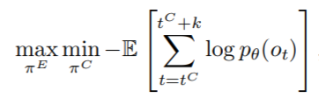
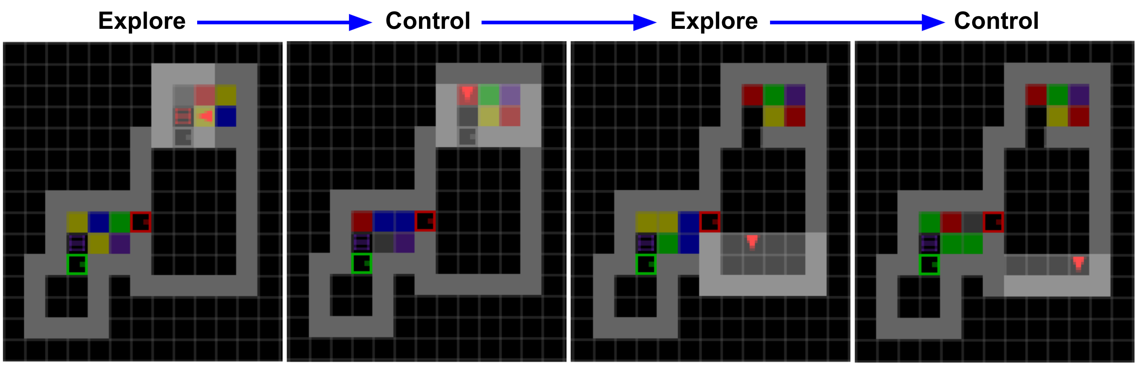




Adversarial Surprise (2021)
Multi-Agent competition: 2 policies take turns controlling an agent
Alice: Explore policy acts first, aims to send agent into surprising, high entropy states
Bob: Control policy takes over, aims to minimise surprise by finding familiar, low entropy states
Addition of flashing light tiles, which changes colour stochastically, with a switch to turn it off
density model
Flashing lights on
Flashing lights off
Goes to next room
Hides in a corner

Slide 6
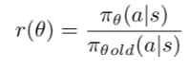
implementation
Deep Neural Network (DNN), conditioned on stack of last 4 frames
Proximal Policy Optimisation (PPO: Gradient Policy Network estimating actions and values
Partially Observed Markov Decision Process: States, Actions, Rewards
Maximum Likelihood Estimation (MLE) fits observations of agent to model
policy ratio must be within 1
Auto curricula conditions: Dynamic Environment + Competition = Innovation
Emergence of complex strategies as both policy adapts to each other

Slide 7
Results
Flashing lights with dark rooms
All dark rooms
Dark rooms with dynamic obstacles
Large rooms with flashing lights and dark rooms (maximum size of 16 x 16)
Flashing lights, dark rooms and dynamic obstacles
Locked doors and keys with dynamic obstacles and dark rooms
Locked doors and keys with dynamic obstacles and dark rooms (Attempt 2)

Slide 8
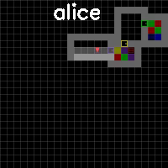
Flashing Lights with dark Rooms
300 epoch: Observed that both agents can open doors to get to all the rooms and Bob knows how to toggle the switch

Slide 9
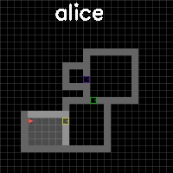
All dark rooms
170 epoch:
Observed that the agent managed to open the door to next room

Slide 10
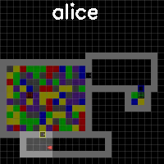
Large rooms with flashing lights and dark rooms (maximum size of 16 x 16)
250 epoch: Agent does not learn any skills as the rooms are too big for the agents to comprehend the current environment

Slide 11
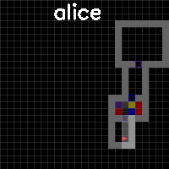
Flashing lights, dark rooms and dynamic obstacles
100 epoch:
Alice learns to open the door as it attempts to get
into the high entropy room

Slide 12
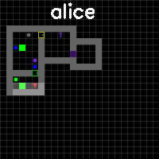
Locked doors and keys with dynamic obstacles and dark rooms
235 epoch: Alice learns it needs to take the key

Slide 13
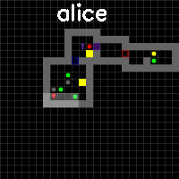
Locked doors and keys with dynamic obstacles and dark rooms
240 epoch: Possibility that Bob toggles the switch off when the obstacle is blocking the door

Slide 14
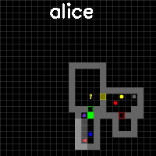
Locked doors and keys with dynamic obstacles and dark rooms
270 epoch: Bob starts steals the key to prevent Alice from getting out

Slide 15
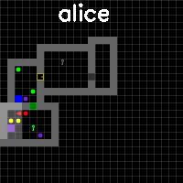
Locked doors and keys with dynamic obstacles and dark rooms (Attempt 2)

Slide 16
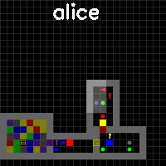
Locked doors and keys with dynamic obstacles and Flashing Lights (FINAL)
45 Epoch: Alice actually toggles off the switch so that and stays still in order to block Bob

Slide 17
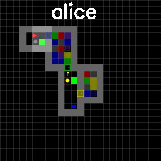
Locked doors and keys with dynamic obstacles and Flashing Lights (FINAL)
140 Epoch: Bob blocks Alice from getting out by toggling the switch

Slide 18
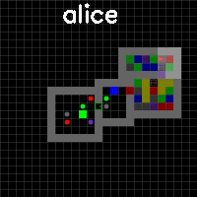
Locked doors and keys with dynamic obstacles and Flashing Lights (FINAL)
500 Epoch: Alice steals the switch so that Bob cannot toggle it
before her round ends, she move herself to the furthest away from the switch

Slide 19
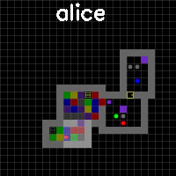
Locked doors and keys with dynamic obstacles and Flashing Lights (FINAL)
800 Epoch: Bob toggles the box off and steals the box so that Alice cannot toggle it back on

Slide 20
Conclusion
Emergent Complexities observed: skill acquisition, navigation and counter-plays
Overfocus on denying other agent instead of traversing through rooms
Training with other environments or hyperparameters could see more elaborate strategies
Explore and Control strategies could be allocated a different amount of steps
Training with other policies could assist with memory issues

Slide 21
Thank You!
Irwin Chin De Tao A0205393H
Goh Kheng Xi, jevan A0199806L

